Slide 1
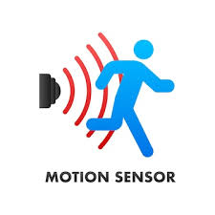


Human Motion Detection System Using PIR Sensor and Arduino for Smart Security
Presented by:
G.Manoj 192312234
G.Chandu 192312154
ECA0711-TRANSDUCERS AND SENSORS FOR NAVIGATION SYSTEMS
Date: 15/07/2025

Slide 2
Introduction
Overview of the project:
This project uses a PIR sensor with Arduino to detect human movement for smart security purposes.
Problem statement:
The problem is how to detect human movement easily to improve security using simple and low-cost technology.
Purpose of the project:
The purpose of this project is to detect human movement using a PIR sensor and Arduino to improve home and area security.

Slide 3
01
To detect human movement using a PIR sensor.
Objectives
02
To alert through a buzzer when motion is detected.
03
To build a simple and low-cost security system using Arduino.

Slide 4
Methodology…
Connect PIR sensor to Arduino – set up wiring for motion detection.
Integrate output device – connect buzzer or LED to alert when motion is detected.
1
3
Write and upload code – program Arduino to read PIR sensor data.
Test the system – check detection range and response for smart security use.
2
4

Slide 5
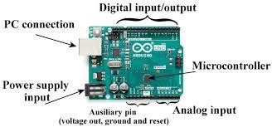
System Design
Process Signal: Arduino reads the sensor output.
Trigger output – If motion is detected, Arduino activates a buzzer or alarm.
Sense Motion
Display status – Optionally, use LEDs to show motion detection status.
Power supply – Provide stable power to Arduino and PIR sensor.

Slide 6
Results & Discussion
Successful Detection: The PIR sensor accurately detected human motion within its range and triggered the buzzer alarm instantly.
1
Low Power Consumption: The system used very little power, making it suitable for continuous smart security monitoring.
2
Easy Integration: The Arduino-based design was simple to program and can be easily expanded for advanced security features like SMS alerts or camera activation.
3

Slide 7
Limitations
Limited range – PIR sensors can only detect motion within a short distance.
No direction detection – It senses movement but cannot tell which way a person is moving.
False alarms – Heat from pets or sunlight can sometimes trigger the sensor by mistake.

Slide 8
Future Scope
Can be upgraded to send alerts to smartphones for real-time security monitoring.
Can be integrated with cameras to automatically record videos when motion is detected.

Slide 9
Conclusion
01
The system successfully detects human motion using a PIR sensor.
02
It alerts instantly through the Arduino-controlled output (e.g. buzzer or alarm).
03
It is low-cost, simple, and useful for smart security applications.

Slide 10
References
Akinwumi et al. (2021) – Arduino + PIR for motion detection with GSM alerts.
Agrawal et al. (2019) – Motion detection system sends alerts to Android app.
CircuitDigest (2021) – Tutorial on Arduino motion detector using PIR sensor.
ElectroPeak (2019) – Gesture and motion detection using PIR with Arduino.
Arun-Roshan (2024) – PIR security system with OLED display animations.
Electronicshub (2024) – Easy PIR sensor interfacing with Arduino tutorial
GeeksforGeeks (2024) – Simple Arduino PIR motion detection system guide.
Wikipedia (2024) – Basics of PIR sensors and security system applications.

Slide 11


